Slide 1

Applied Computing Slideshows by Mark Kelly vcedata.com mark@vcedata.com Last modified 2024-08-13
Project
Management

Slide 2
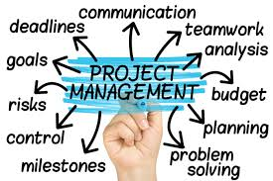
What is project management?
identifying tasks, resources, people and time
scheduling tasks, resources, people and time
monitoring tasks, resources, people and time

Slide 3
What is a Project?
A series of tasks worked on by several people within constraints of time, money and resources, to achieve a desired goal.
Projects are ‘one-off’, unique events – they’re not routine daily or weekly tasks

Slide 4
Typically
Projects are
big – in terms of time, money, resources (e.g. staff), disruption of normal operations,
Big risks of loss, waste or damage if projects are mishandled.

Slide 5
Project Manager
Projects need to be managed
Project Manager organises money, time and resources (equipment, personnel) to ensure project tasks start and finish on time and are not too disruptive, wasteful or costly

Slide 6



Projects must finish
On time
Within budget
Achieving their original goals

Slide 7
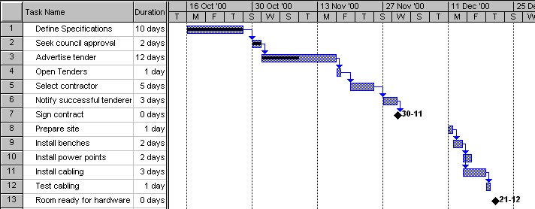
Gantt charts

Slide 8
WBS
A Work Breakdown Structure is a good way of beginning a Gantt chart
In a WBS all the tasks (and subtasks) in the project are identified and put in order of execution.
Ensures necessary jobs are not forgotten!

Slide 9
identifying tasks, resources, people and time
WBS – work breakdown structure
List the tasks and subtasks that need to be done from start to finish
Don’t leave things out!

Slide 10
Sample WBS
WBS number | Task Description
1.0 | Project initiation
1.1 | Draft project plan
2.0 | Analysis phase
2.1 | Plan user interviews
2.2 | Schedule users interviews
3.0 | Examination and test
4.0 | Design
5.0 | Test
6.0 | Implementation
7.0 | Post implementation review
Note how large tasks (e.g. 1 and 2) can be subdivided into subtasks (e.g. 2.1, 2.2). Later, large tasks can be collapsed or expanded to hide or show their subtasks.

Slide 11
monitoring tasks, resources, people and time
The Gantt chart is modified as necessary as the project proceeds so it accurately reflect real events and progress.
Milestones are major progress landmarks.
Milestones tell you whether the project is running on time.

Slide 12
Gantt Charts …
Plan necessary tasks in advance.
Monitor progress of a project.
Are used to make predictions.
Show task dependencies and timing
But I know you want MORE
see the projman-gantt slideshow
I DARE you

Slide 13
Applied Computing Slideshows
by Mark Kelly
vcedata.com
mark@vcedata.com
These slideshows may be freely used, modified or distributed by teachers and students anywhere on the planet (but not elsewhere).
They may NOT be sold.
They must NOT be redistributed if you modify them.

